Slide 1

EMOTION ECHO

Slide 2
Team Members
ANJALI KUMARI – 11501621015
MEENAKSHI SHARMA – 11500321028
ISHIKA RANA - 11500221055
DIPANJAN SAHA - 11500221056

Slide 3
Introduction
Emotion Echo is an AI-powered platform designed to detect and manage anxiety by analyzing physiological and behavioral data.
The key Features are:
Real-time tracking of heart rate and facial expressions to assess anxiety levels.
The platform detects anxiety through personalized questions consulted by psychiatrists to determine the user's anxiety.
It integrates personality-based analysis to offer more tailored recommendations, making it a comprehensive tool for mental well-being.

Slide 4
PROBLEM STATEMENT
Mental health tools are episodic, intrusive, or delayed.
Limitations:
Single-source data
Latency in real-time use
Privacy issues with wearable/social media monitoring
Emotion Echo solves these with multi-modal, real-time, and adaptive monitoring.

Slide 5

PROJECT OBJECTIVE
To detect, monitor, and respond to real-time anxiety levels in users by analyzing emotional, physiological, and psychological inputs.
Depression Questionnaire
Facial Emotion Recognition (FER)
Users answer standard psychological questions; the score reflects mental health severity.
Uses a custom CNN to analyze facial expressions via webcam and assign emotion scores in real time.
Heart Rate Monitoring
Anxiety Score Generation
Measures BPM using MAX30102 sensor or allows manual input to assess physiological stress levels.
Combines all three inputs using a weighted formula to produce a real-time anxiety score.

Slide 6
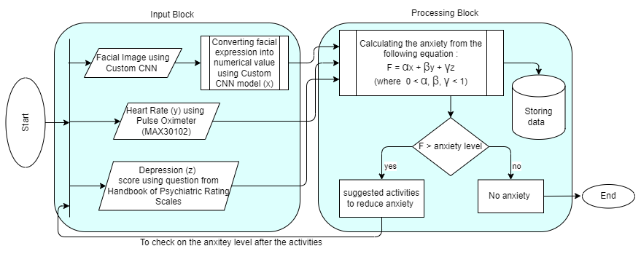
FLOW DIAGRAM

Slide 7

ANIXETY SCORE CALCULATION
Formula: Anxiety Score = (α × Emotion Score) + (β × Heart Rate Score) + (γ × Depression Score)
Example Weights: α = 0.3, β = 0.3, γ = 0.4
Output Scale:
< 0.4: Low Anxiety
0.4–0.7: Moderate Anxiety
> 0.7: High Anxiety

Slide 8
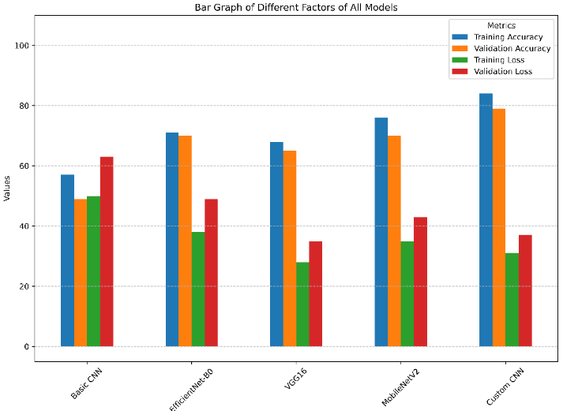
WHY CUSTOM CNN ?
Custom CNN achieved 82% accuracy with low computational cost
Pre-trained models like VGG16 and EfficientNet-B0 are accurate but heavy
MobileNetV2 is fast and light but slightly less accurate
Custom CNN offers the best balance for real-time deployment

Slide 9
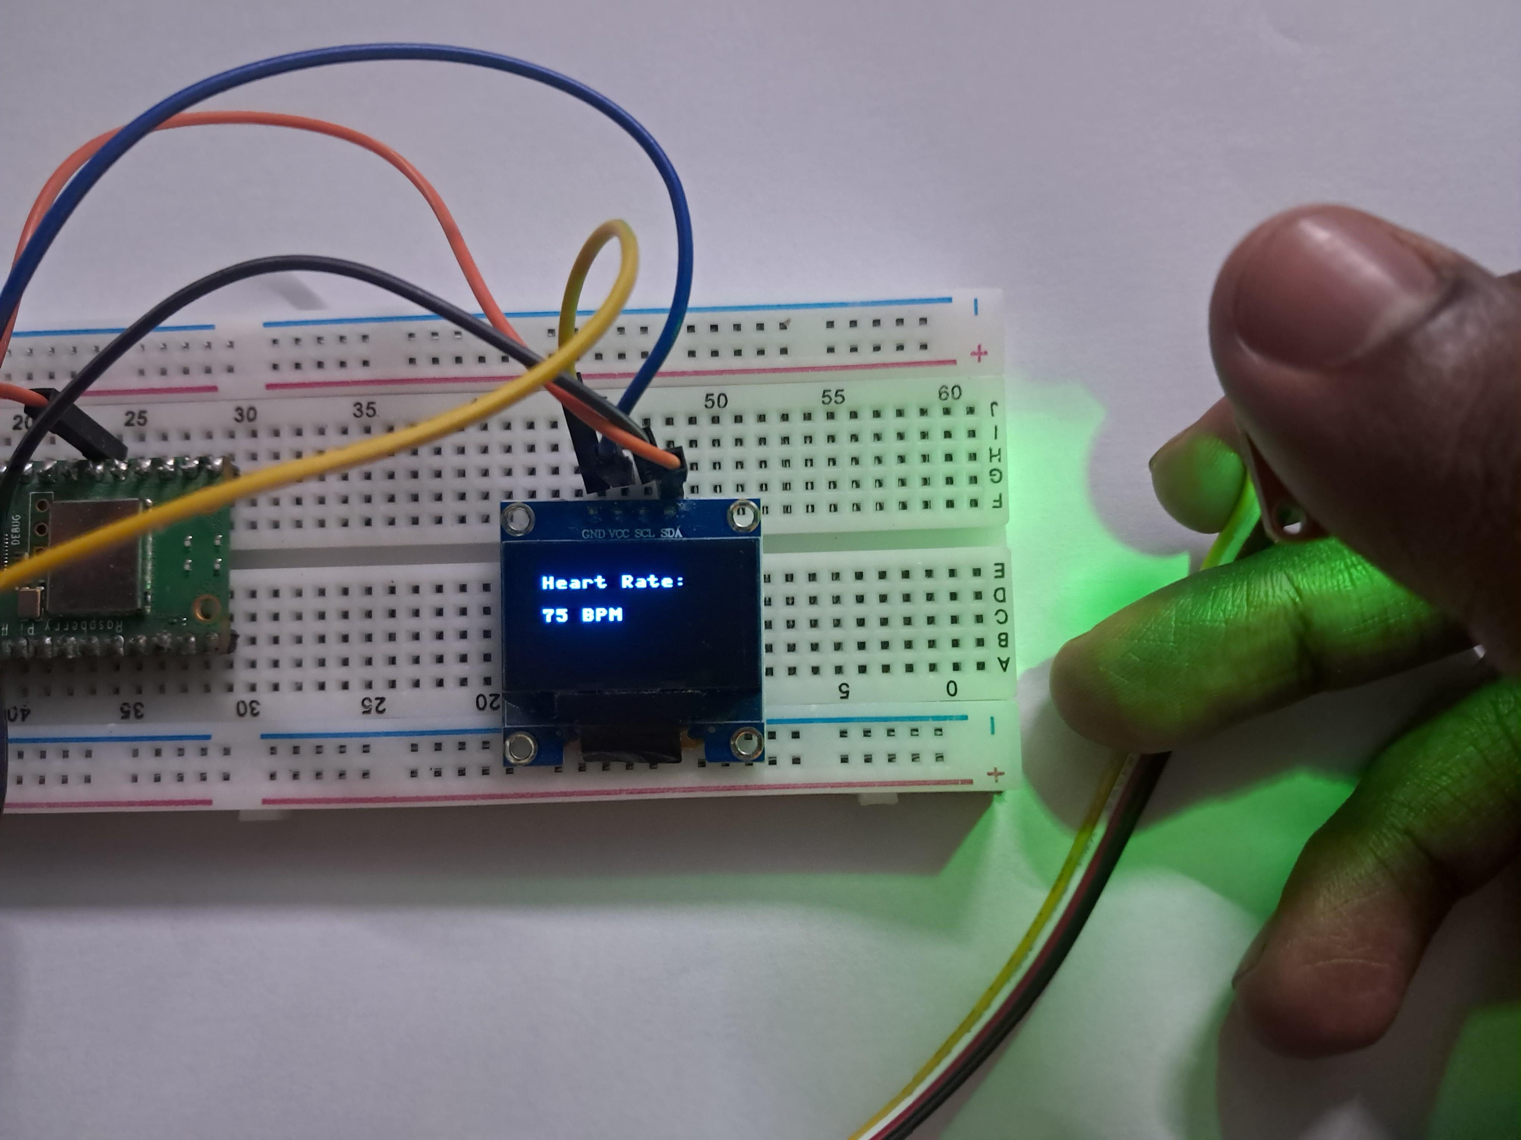
TECHOLOGIES & HARDWARE
Software:
Python, TensorFlow, OpenCV, Streamlit, Flask, Google Colab, GitHub
Hardware:
Raspberry Pi Pico
MAX30102 pulse sensor
OLED Display (SSD1306)
Webcam (for emotion detection)

Slide 10
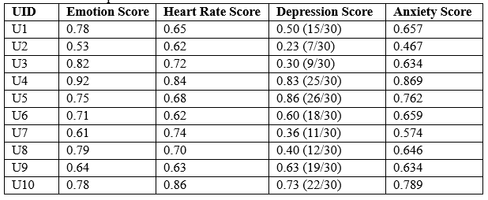
RESULT SIMULATION
To ensure the authenticity of the test results, we have selected individuals from diverse backgrounds, attitudes, and personalities.

Slide 11
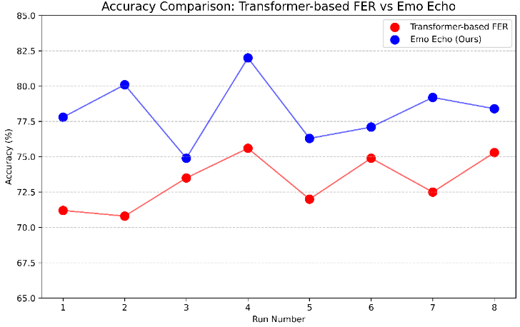
BENCHMARK COMPARISON
Combines facial cues, heart rate, and behavior for deeper emotional insight
Delivers real-time, personalized anxiety scores with clinical relevance
More accurate than transformer-based FER models (74–82% vs 70–75%)
Reduces misinterpretation by going beyond static facial expression analysis

Slide 12
CHALLENGES
Multi-Source Integration: Merging facial, heart rate, and questionnaire data was technically complex.
Hardware Handling: Being new to hardware, tasks like wiring, sensor setup, and microcontroller connections were challenging.
Real-time Processing: Ensuring smooth performance on low-power hardware required careful optimization.

Slide 13
FUTURE SCOPE
Reinforcement Learning for adaptive response
Historical Data Comparison
Single embedded device (sensor + camera)
Chatbot Integration for empathetic conversations
Direct access to professionals

Slide 14
Conclusion
Emotion Echo is an intelligent, multi-modal anxiety detection system.
Combines emotion, physiological, and psychological data.
Superior to traditional systems:
Real-time
Personalized
Mobile-compatible
A promising solution for early mental health intervention

Slide 15
References
https://doi.org/10.1016/j.bspc.2016.06.020.
https://www.sciencedirect.com/science/article/pii/S1746809416300805
https://github.com/kumarvivek9088/Face_Emotion_Recognition_Machine_Learning
https://www.kaggle.com/datasets/msambare/fer2013
Lyerly, S.B., Abbott, P.S.: Handbook of Psychiatric Rating Scales (1950–1964). Psycho-logical Assessment Associates, National Institute of Mental Health.

Slide 16
Thank you

